Slide 1
Exception Handling
Rajasekaran S
Assistant Professor,
Department of Information Technology,
KGiSL Institute of Technology,
email: proffraja@gmail.com
Github:www.github.com/rajasekaranap

Slide 2
Exception
In Java, an exception is an event that disrupts the normal flow of the program.
It throws an exception object at runtime.
We have to handle the exceptions to make the system in safe sate.

Slide 3
Unsafe Sate
Loss of Progress and Inconsistent Data
Terminate Execution
NO
Exception Occurred
Handle Exception
Continue Execution
Start
Stop
YES
Safe Sate
Is possible to continue with changes?
YES
Make Changes
NO
Roll Back Previous
Safe Terminate

Slide 4
Causes for Exception
A user has entered an invalid data.
A file that needs to be opened cannot be found.
A network connection has been lost in the middle of communications or the JVM has run out of memory.
Programming Errors.
Physical Resource Failure [Hard Drive Failure].

Slide 5
Types of Exceptions
Exceptions
Unchecked Exceptions
Errors
Checked Exceptions

Slide 6
Types of Exceptions
Checked Exceptions
It will rise at the compile time.
The programmer must handle before the compilation of the program.
FileNotFoundException
Unchecked Exceptions
This will rise at runtime and checked at runtime
It is raised by program errors, logic errors and Improper use of API’s.
It is ignored at the time of compilation.

Slide 7
Types of Exceptions
Errors
We cannot handle this situation.
Problem arise beyond the control of user and programmer.
Eg: Hardware and Network failures, Stack Overflow Errors.
It is ignored by code in both compile time and runtime.

Slide 8
Exception Hierarchy
Java.lang
Object
Throwable
Errors
Exceptions
StackOverFlow Error
VirtualMachine Error
OutOfMemmory Error

Slide 9
Exception Hierarchy
Exceptions
Runtime Exceptions
IOException
SQL Exception
Class Not Found Exception
Arithmetic Exception
IndexOutOfBounds Exception
NullPointer Exception
StringIndexOutOfBounds Exception
ArrayIndexOutOfBounds Exception
NumberFormat Exception

Slide 10
Exceptions
Runtime Exceptions
A bad cast
An out-of-bounds array access
A null pointer access
IOExceptions
Trying to read past the end of a file
Trying to open a file that doesn’t exist

Slide 11
Basic Blocks of Exceptions
Critical Section
A Section of a program that deals with resources that may rise exceptions.
Try Block
A block that contains critical sections of program.
Catch Block
A block of code that understands and handles the exceptions.

Slide 12
Syntax
try{
//critical section
throw new Exception()
}
catch(exceptions){
//exception handling code
}
try{
//critical section
throw new Exception()
}
catch(exception type 1){
//exception handling code
}
catch(exception type 2){
//exception handling code
}
Simple Try Catch
Multi-Catch

Slide 13
Syntax
try{
//critical section
try{
//critical section
throw new Exception()
}
catch(exception type 1){
//exception handling code
}
throw new Exception()
}
catch(exception type 2){
//exception handling code
}
try{
//critical section
throw new Exception()
}
catch(exception type 2){
try{
//critical section
throw new Exception()
}
catch(exception type 1){
//exception handling code
}
}
Try within Try
Catch has Try

Slide 14
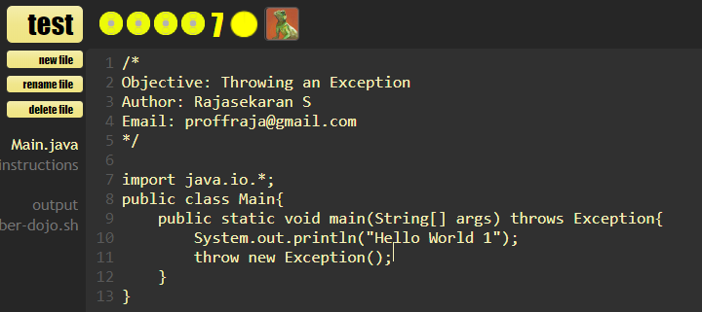
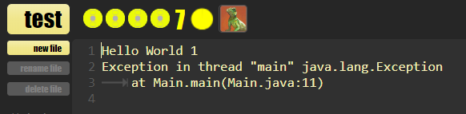
Throwing an Exceptions
Throwing Exception

Slide 15
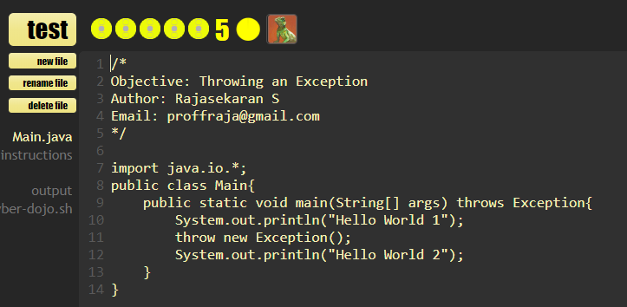
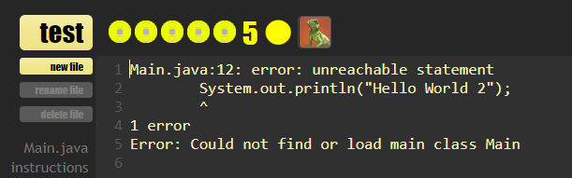
Problems of unhandled Exception
Unhandled Exception

Slide 16
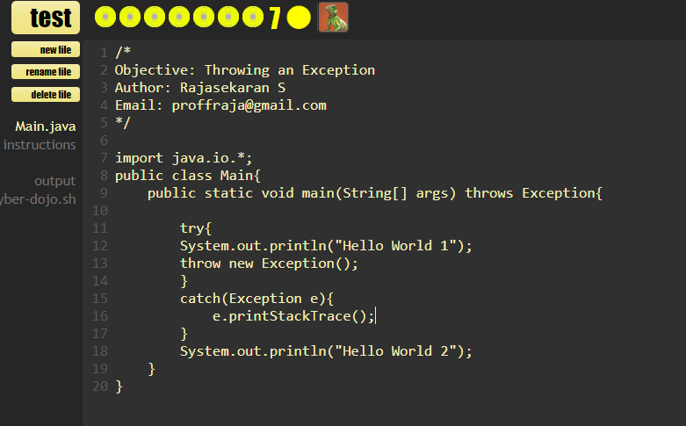
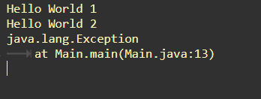
Handling Exceptions
Handling Exception
http://www.cyber-dojo.org/review/show/wZceyFfnPQ?avatar=lizard&was_tag=6&now_tag=7&filename=undefined

Slide 17
Built-in Exceptions
S. No | Exception and Description
1 | ArithmeticException Arithmetic error, such as divide-by-zero.
2 | ArrayIndexOutOfBoundsException Array index is out-of-bounds.
3 | ArrayStoreException Assignment to an array element of an incompatible type.
4 | ClassCastException Invalid cast.
5 | IllegalArgumentException Illegal argument used to invoke a method.

Slide 18
Built-in Exceptions
S. No | Exception and Description
6 | IllegalMonitorStateException Illegal monitor operation, such as waiting on an unlocked thread.
7 | IllegalStateException Environment or application is in incorrect state.
8 | IllegalThreadStateException Requested operation not compatible with the current thread state.
9 | IndexOutOfBoundsException Some type of index is out-of-bounds.
10 | NegativeArraySizeException Array created with a negative size.

Slide 19
Built-in Exceptions
S. No | Exception and Description
11 | NullPointerException Invalid use of a null reference.
12 | NumberFormatException Invalid conversion of a string to a numeric format.
13 | SecurityException Attempt to violate security.
14 | StringIndexOutOfBounds Attempt to index outside the bounds of a string.
15 | UnsupportedOperationException An unsupported operation was encountered.

Slide 20
Built-in Exceptions Checked
S. No | Exception and Description
1 | ClassNotFoundException Class not found.
2 | CloneNotSupportedException Attempt to clone an object that does not implement the Cloneable interface.
3 | IllegalAccessException Access to a class is denied.
4 | InstantiationException Attempt to create an object of an abstract class or interface.

Slide 21
Built-in Exceptions Checked
S. No | Exception and Description
5 | InterruptedException One thread has been interrupted by another thread.
6 | NoSuchFieldException A requested field does not exist.
7 | NoSuchMethodException A requested method does not exist.

Slide 22
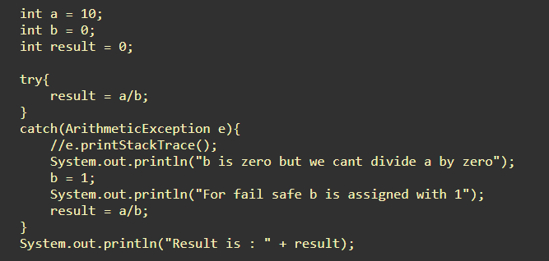
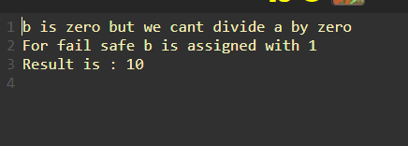
Arithmetic Exception
http://www.cyber-dojo.org/review/show/wZceyFfnPQ?avatar=lizard&was_tag=9&now_tag=10&filename=undefined

Slide 23
Multiple Catch
It has one try and multi-catch statement.
It performs different tasks for a different exceptions.
http://www.cyber-dojo.org/review/show/SV6CnDy973?avatar=hippo&was_tag=1&now_tag=2&filename=undefined

Slide 24
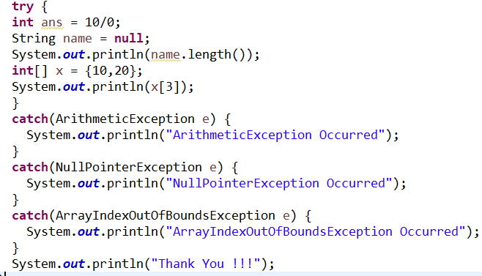
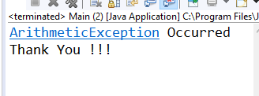
Multiple Catch

Slide 25
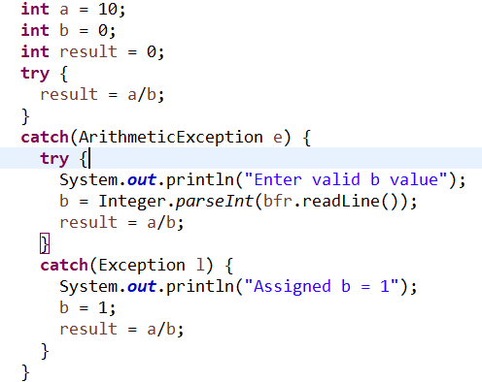
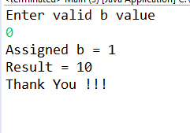
Try within Catch

Slide 26
Finally Block
Java finally block is a block that is used to execute important code such as closing connection, stream etc.
Java finally block is always executed whether exception is handled or not.
Java finally block follows try or catch block.

Slide 27
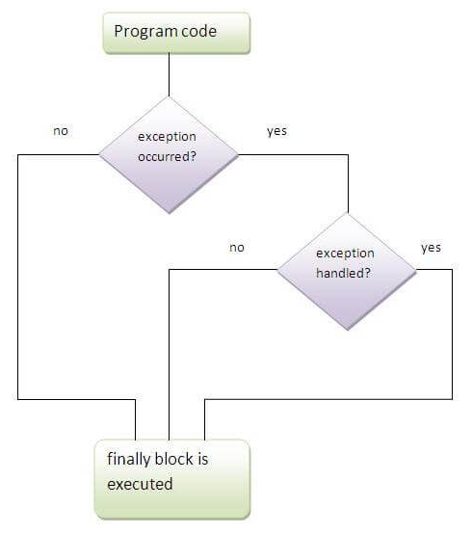
Finally Block

Slide 28
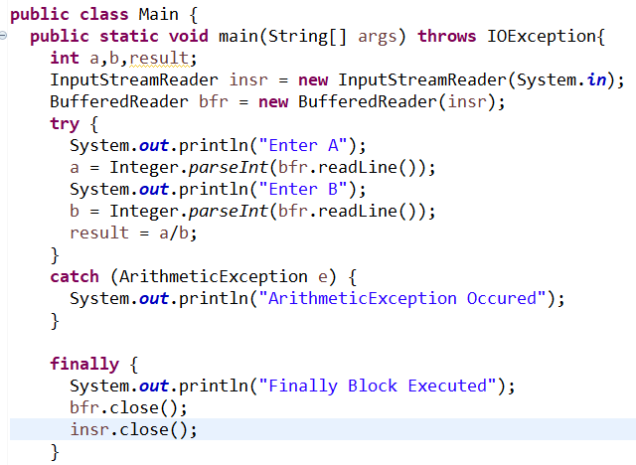
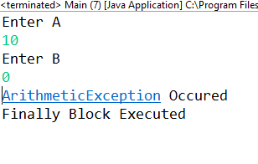
Finally Block

Slide 29
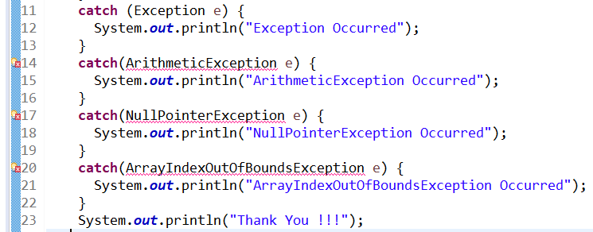
Exception Hierarchy
Base
Sub

Slide 30
User Defined Exception
User can create custom exception classes
User defined class must extend from any one of exception classes.
Constructor to be configured for getting message.
User explicitly throws exception from try block.
Catch block must handled user defined exception.

Slide 31
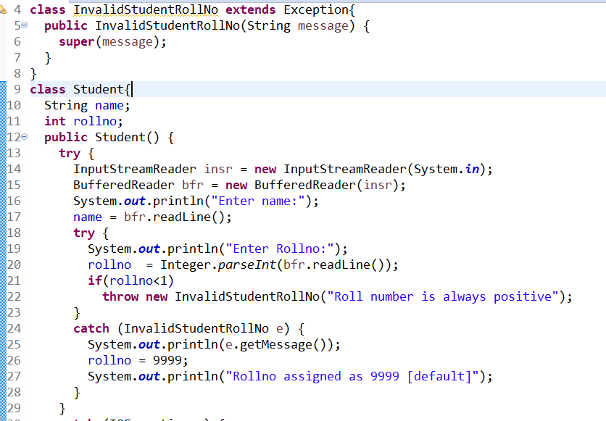
Step 1
Step 2
Step 3
Step 4

Slide 32
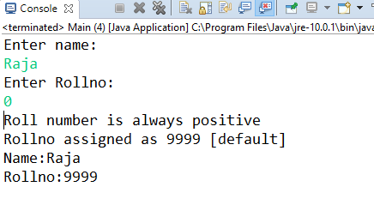
Output

Slide 33
Stack Trace Elements
It is a class comes from java.lang.StackTraceElement
It can hold one stack frame
A single stack frame consist of
Local variables
Saved copies of registers modified by subprograms that could need restoration
Argument parameters
Return address
It collects the stack frame details at execution point using getStackTrace() methods.

Slide 34
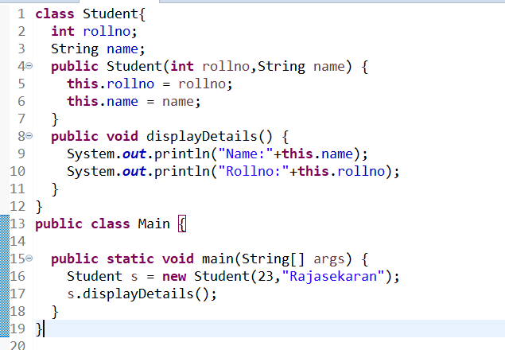
Need of StackTraceElement
Base
Full Satck
Main Class
main()
Student Class
displayDetails()
Top Frame

Slide 35
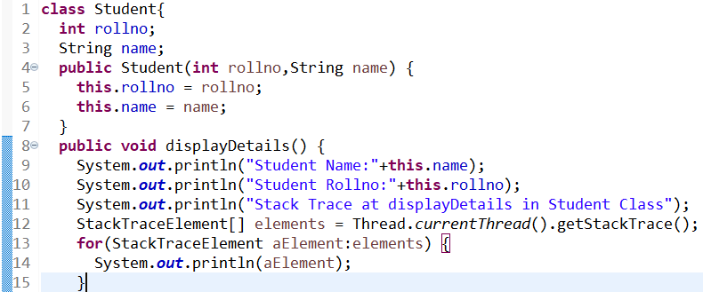
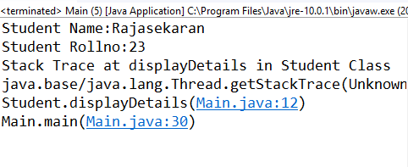
Stack Trace Element
Execution Point

Slide 36
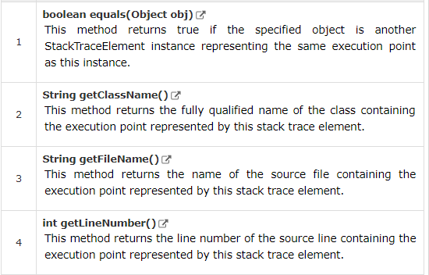
Methods

Slide 37
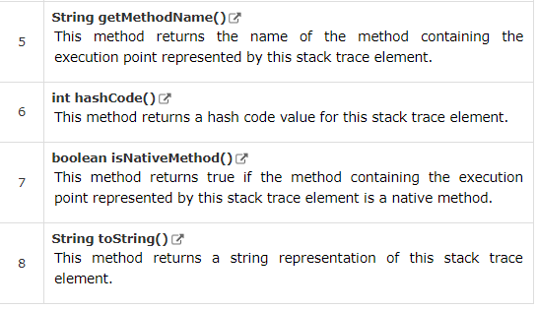
Methods

Slide 38
Thank You
Rajasekaran S
Assistant Professor,
Department of Information Technology,
KGiSL Institute of Technology,
email: proffraja@gmail.com
Github:www.github.com/rajasekaranap

